Slide 1
Writing and Testing
High Frequency Trading System
Designing and monitoring for latency
Higher Frequency Trading
Peter Lawrey

Slide 2
Who am I?
Australian living in UK. Three kids 5, 8 and 15
Five years designing, developing and supporting HFT systems in Java
My blog, “Vanilla Java” gets 120K page views per month.
3rd for Java on StackOverflow
Lead developer for OpenHFT which includes Chronicle and Thread Affinity.

Slide 3
* Outline *
High level priorities of HFT
More detailed theory
Low level coding
Scaling your system
Low level system monitoring and testing
Why JVM tuning shouldn't be an issue.

Slide 4
High level priorities of HFT
Understandability and transparency is key.
You cannot make reasonable or reliable performance choices without good measures.
Keeping it simple, means making everything it is really doing easy to understand. Not how short is my code, or how easy is it to write.

Slide 5
Why Java for HFT?
A typical application spend 90% of the time in 10% of the code.
Java makes writing the 10% harder, often gets in your way.
Java make writing the 90% easier, often helps you by giving you less to worry about
In a mixed ability team and with limited resources, the code you produce will be as fast or faster than C++.

Slide 6
What is HFT?
Definitions for HFT vary based on context.
Clear relationship between latency and money.
Timings are too short to see, and must be measured.
Systems have specific, measurable timing requirements in the milli-seconds or micro-seconds.
A new “HFT” system often means, much faster than the last system we built. e.g. 10x faster.

Slide 7
What difference does it make?
Design assumes all performance problems can be solved directly.
Critical paths must be identified and optimised for first. If these are not fast enough nothing else matters.
Ultra low GC, low resource contention.
Most operations must be persisted for records, replaying and diagnosis.
Every action must be timed to micro-seconds

Slide 8
What difference does it make?
The layers of abstraction are minimised and thinned. System is much more aligned to business needs
Technical risk depends on business risk.
The system stopping is not the worst thing which can happen.
The system should only do what the business needs and as little extra as possible.
More time spent understanding the system and removing anything not needed, than adding functionality.

Slide 9
Typical project plan
Identify the requirements, keeping them as simple as possible.
Build a skeleton system of critical functionality end to end. Make sure this performs as required.
Add less critical functionality to “off the critical path”.
Integrate with other systems.

Slide 10
Performance monitoring
Performance measures are part of the system from the start.
Expect the performance of the system to be beyond the help of profilers and third party tools.
Performance is an essential requirement so production must measure itself. It may dynamically reconfigure itself or switch off if too slow.
At key stage in the critical path, time stamps can be taken and accumulated. These timestamps can show you where delays occurred and their impact on fill rates.

Slide 11
Reporting of latency
The latency you are interested in is the worst latencies.
The 99%tile (worst 1%), 99.9%tile, 99.99%tile.
The worst N samples in an interval.
It is not possible to measure the worst you could get, only the worst you got. This makes 99%tile and 99.9%tile useful for testing as they can be reproducible.
The worst latency is usually not more than 10x the worst you get in a decent sample. While worst is difficult to reproduce, an order of magnitude difference is still significant.

Slide 12
* More detailed theory *
Why CPU caches matter.
Low latency and throughput.
Lowering your GC burden
Avoid the kernel on the critical path
How to tune for different latency requirements
  You don't want to be doing more work than you need. i.e. going “as fast as you can” means maximising your cost of development.

Slide 13
More detailed theory
The tools you should be familiar with
The debugger including remote debugging
A commercial performance profiler
How to use System.nanoTime() in your code.
How to tune for different latency requirements
System performance monitoring tools.

Slide 14
CPU caches
L1 cache is typically 32 KB for instructions and data. 4 clock cycles
L2 cache is typically 256 KB. 11 clock cycles
L3 is shared so you want avoid using this.
8 MB to 24 MB.
  Unshared ~40 clock cycles.
  Shared ~ 65 clock cycles.
  Modified in another core ~ 75 clock cycles.
Local DRAM. ~ 200 clock cycles.

Slide 15
Recycling is good
Recycled objects tend to stay in the high level caches. Creating garbage can fill your caches with garbage.
If you are creating 32 MB/s of garbage in one core, you are filling you L1 cache every milli-second with garbage.
Object pooling can help.
Preallocated objects are better/faster.
Requires mutable objects and data copying !!

Slide 16
Recycling is good
Mutable object work best when
The alternative is to use many short lived immutable objects
The life cycle of the objects are simple and easy to reason about.
Data structures are simple.
Can help eliminate GCs, not just reduce them.

Slide 17
Concurrency
There is a broad relationship between low latency and throughput
Lowering the latency generally improves throughput as well.
Throughput = concurrency / latency
Concurrency = throughput * latency

Slide 18
Avoid the kernel
The critical path you want to make as short as possible. The kernels are not implemented this way so there as low latency alternatives
User space, kernel bypass network adapters
Can reduce user space to user space latency from 40 micros to less than 10 micros.

Slide 19
Avoid the kernel
Memory mapped files offer persistence without a system call per access. New mapping are ~ 20 – 100 micros for 128 MB to 256 MB.
Memory mapped files also offer low latency IPC. You can send a message between processes/thread under 100 nano-seconds.
Java Chronicle can write billons of messages to the sustained write speed of your drive. e.g. 900 MB/s on a PCI SSD

Slide 20
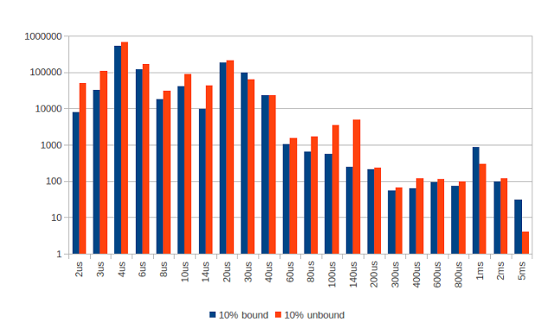
Avoid the kernel
Binding without isolation may not make much difference.
Count of interrupts
per hour by length.

Slide 21
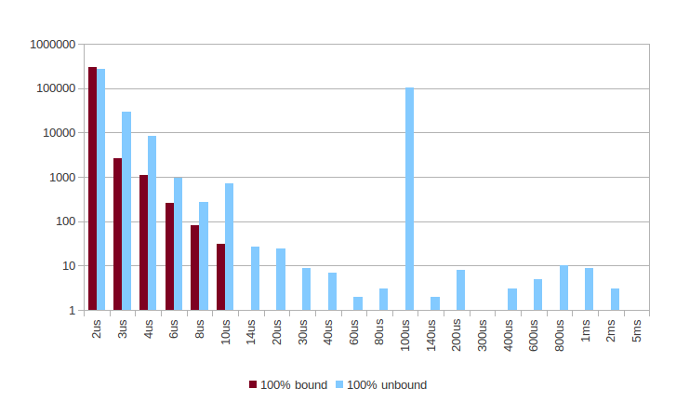
Avoid the kernel
Binding critical, busy waiting threads to isolated CPUs can make a big difference to jitter.
Count of interrupts
per hour by length.

Slide 22
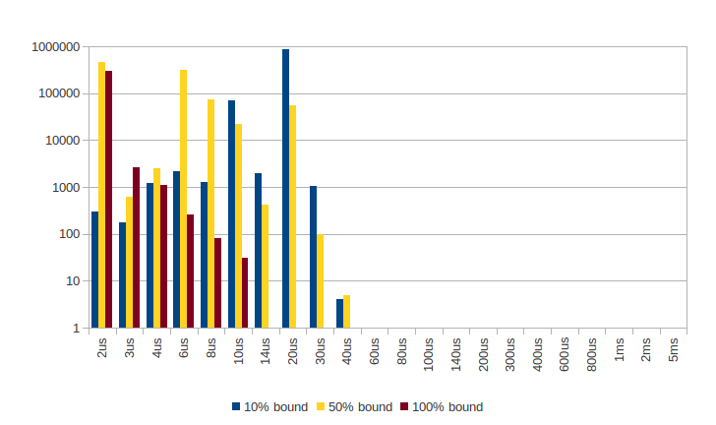
Avoid the kernel
Busy waiting threads have warmer caches but may get interrupted less.
Count of interrupts
per hour by length.

Slide 23
* Low level coding *
Unsafe allows you fine, low level control which is not otherwise available directly in Java.
It is not cross platform, but can be worth it.
Can be 5% - 30% faster in real applications
Something you want to layer, test by itself and hide away.

Slide 24
Unsafe
Allows
get/set fields in objects randomly
get/set primitives in memory
thread safe volatile and ordered for some types.
Compare and set access to objects or native memory

Slide 25
Unsafe
Also allows
Allocate, resize and free native memory
Copy memory to/from objects and native memory.
allocateInstance without calling a constructor
Blindly throw checked exceptions
Discretely enter/exit/try a synchronized monitor

Slide 26
Off heap memory
Pros
Minimal GC overhead for large amounts of data.
Can be shared between processes.
More cache friendly

Slide 27
Off heap memory
Cons
Unnatural in Java so you have to hide it away in a library.
Can be slower with ByteBuffer
Much more work depending on the complexity of your data structures and their life cycle.

Slide 28
Faster math
Use double with rounding or long instead of BigDecimal ~100x faster and no garbage
Use long instead of Date or Calendar
Use sentinal values such as 0, NaN, MIN_VALUE or MAX_VALUE instead of nullable references.
Use Trove for collections with primitives.

Slide 29
Lock free coding
Minimising the use of lock allows thread to perform more consistently.
More complex to test.
Only useful in ultra low latency context
Will scale better.

Slide 30
* Scaling your system *
How far you tune your system depends on the level of performance you require.
The end to end system is what matters.
This includes the part which you might feel you have little control over. They still impact latency.

Slide 31
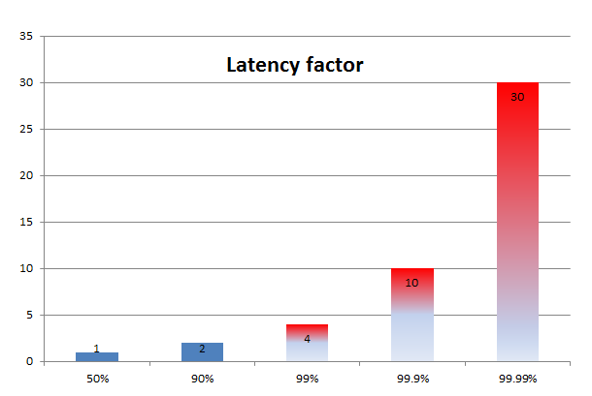
Latency profile
In a complex system, the latency increases sharply as you approach the worst latencies.

Slide 32
100 ms, 99.9% of the time
Typical latency needs to be ~10 ms
You want to CPU and memory profile you system.
Full Gcs very rare, and minor GCs kept low.
Cache data to avoid waiting for external systems, e.g. databases.
Minimise logging to avoid disk write delays.
Time stamp accurate to ~2 ms.

Slide 33
10 ms, 99.9% of the time
Typical latency needs to be ~1 ms
CPU and memory profile very “clean”
No full GCs and minor GCs rare.
All data is copied locally and persistence is asynchronous
Time stamp accurate to ~200 µs.

Slide 34
2 ms, 99.9% of the time
Typical latency needs to be ~200 micro-seconds.
CPU and memory profile very “clean”
No minor GCs collections, or use Azul Zing concurrent collector.
All data is copied locally and persistence is asynchronous
Time stamp accurate to ~40 µs.

Slide 35
200 µs, 99% of the time
Typical latency needs to be ~50 micro-seconds.
Minimum of garbage for clean caches.
Eden size larger than the garbage produced, per day or per week as required.
Kernel bypass for network and disk writes.
Use binding to isolated CPUs for critical threads.
Time stamp accurate to ~10 µs.

Slide 36
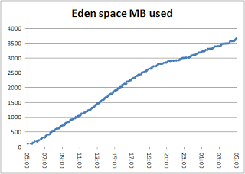
What does a low GC look like?
Typical tick to trade latency of 60 micros external to the box Logged Eden space usage every 5 minutes.
Full GC every morning at 5 AM.

Slide 37
* Low level system monitoring and testing *
To measure low latencies you need a measure better than milli-seconds. There is three options for doing this.
Use System.currentTimeMillis() anyway. This is ok when all you care about is the highest latencies
Use System.nanoTime() but using across distributed systems is tricky
Use JNI/JNA for gettimeofday() or QueryPerformanceCounter(). Still tricky across systems without specialist hardware.
Use JNI to call RDTSC. Very fast, but only accurate on the same core.

Slide 38
Low level system monitoring and testing
Measures need to be simple, easily accessible, and easy to tie to business events.
Extracting value from performance measures takes at least twice as long as the effort to collect them. This often leads to collecting data which is never used.
The way I get around this is to tie the timing measures to the critical path and make dividing performance measures with the key business events part if the initial deliverables.

Slide 39
Distributed timing
You can use expensive hardware to get a accurate timing, but in general you don't need it.
What you care about is the high latency timings.
This means you need to know when the latency is higher than normal or the best timings you got.

Slide 40
Distributed timing
You can do this by distributing System.nanoTime() and taking a running minimum with a small drift (say 1 in on million)
You know the minimum latency cannot be less than 0 and you can measure it with round trip times and it should be very stable.
You normalise the minimum latency and this will tell you if you have a latency higher than this. As most latency you are interested in are much higher, not knowing the true minimum doesn't matter so much, you can still detect outliers. You can get around 10 micro-second accuracy.

Slide 41
Measure your system first
It is important to understand the performance of you system you can achieve in Java.
Measure the jitter you thread sees over a few hours. e.g. jHiccup or busy calls to System.nanoTime() and measure the distribution. Your program won't be better than this.
Measure your network latencies using round trip times with System.nanoTime() for realistic message sizes.
Measure the time it takes to serialize and deserialize your data.

Slide 42
Measure your system first
Measure your persistence layers. Should these be asynchronous or is there a synchronous option.
Measure your IPC if you have one. If you are using RV or JMS, can this be asynchronous and off the critical path, ideally in another process or machine.
Measure your kernel bypass options for latency

Slide 43
Measure your system first
For all latencies you should consider the distribution of those latencies. Systems which are simpler have less jitter and I suggest using
the 99.9% latency if you require 99% for your system.
99.99% if you require 99.9% for you system.
If you require a worst latency measure, multiply what you measured by 10x.

Slide 44
Measurable critical path.
When developing your critical path, include timing at key point along your system.
Have your system warm up on start up before measuring.
If a timing stage is too short remove it. It too long try to find a point in between.
Make sure recording and persisting the timings do not significantly impact perform itself.

Slide 45
Timing business events
Store the timing with the business events and process this timing against key metrics as the event occur i.e. in real time.
This can be used to re-route market data and orders.
Much more likely to be used and delivered than timings done as an after thought.

Slide 46
* JVM parameters *
While many talk about how to tune the GC, you can get much better results if you don't depend on it so much, or at all.
Low garbage rate improve cache hit rates
Less to tune in the JVM
Easier to see in a memory profiler (less noise)
Ultra low garbage pressure means the GC tuning is less important.

Slide 47
JVM parameters
Parameters to consider
Reduce the maximum size to 4 GB for optimal memory access. The default may be higher.
-verboce:gc redirected to a file to check you are not GC-ing. Xloggc is buffered so you might not get any output.
Disable DGC triggered collections.

Slide 48

Q & A

